Slide 1











BY
Pasindu Mahima
Search . . .
NGATOR
LEARNING
SAD PRESENTATIONS
learn.ngator.com

Slide 2




BY
Pasindu Mahima
Search . . .
IMPORTANT POINTS TO REMEMBER
JAVA GUI COMPONENTS
AND LAYOUTS
JAVA LIBRARIES
JAVA DATA STRUCTURES
BASIC PROCESSES
Arrays
Vectors
HashMap
Java AWT Components
Java Swing Components
Adding data to a Table
Adding items to a Combo Box
MySQL
Jasper Reporting
Adding a custom theme

Slide 3
BY
Pasindu Mahima
Search . . .
JAVA LAYOUTS
Absolute Layout
Border Layout
Box Layout
Card Layout
Flow Layout
Grid Bag Layout
Grid Layout
Group Layout

Slide 4
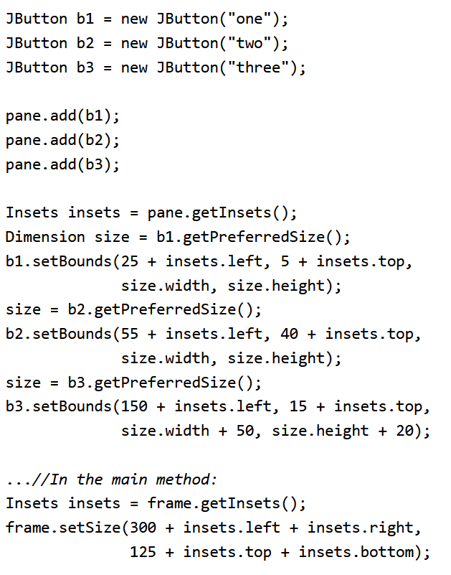
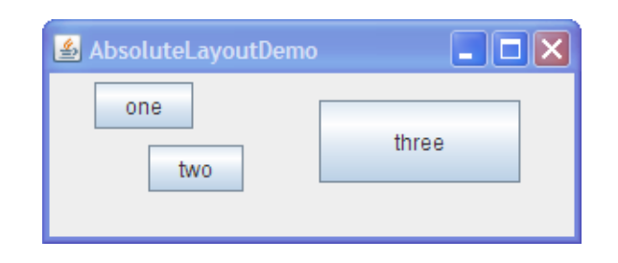
BY
Pasindu Mahima
Search . . .
ABSOLUTE LAYOUT(WITHOUT A LAYOUT MANAGER)

Slide 5
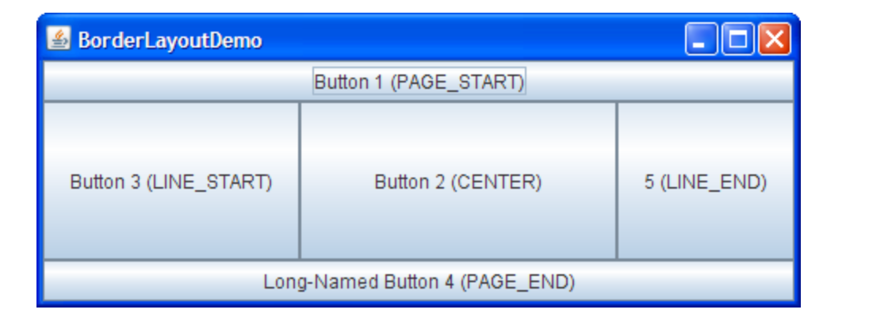
BY
Pasindu Mahima
Search . . .
BORDER LAYOUT
A Border Layout places components in up to five areas: top, bottom, left, right, and center. All extra space is placed in the center area.

Slide 6
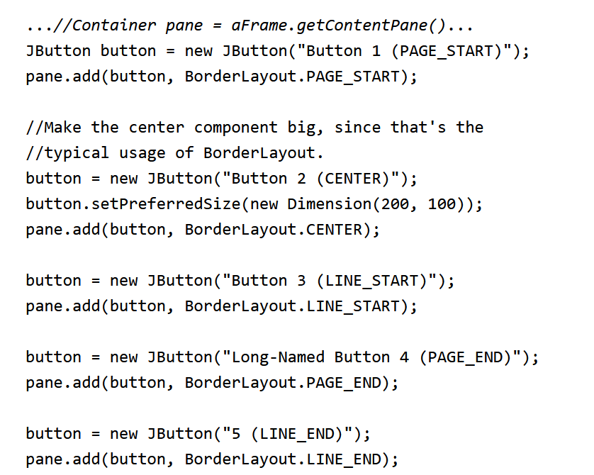
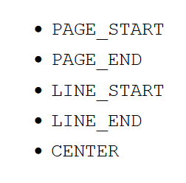
BY
Pasindu Mahima
Search . . .
BORDER LAYOUT

Slide 7
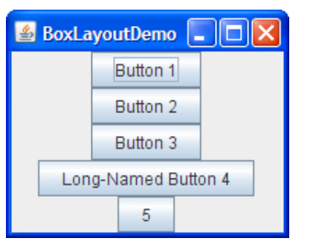
BY
Pasindu Mahima
Search . . .
BOX LAYOUT
The BoxLayout class puts components in a single row or column. It respects the components' requested maximum sizes and also lets you align components.

Slide 8
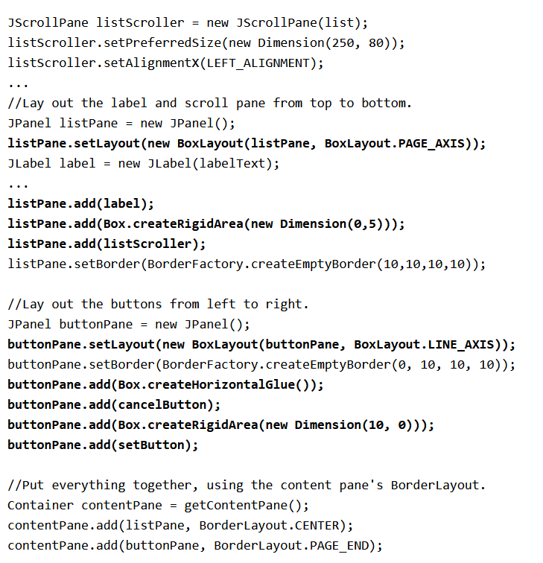
BY
Pasindu Mahima
Search . . .
BOX LAYOUT

Slide 9
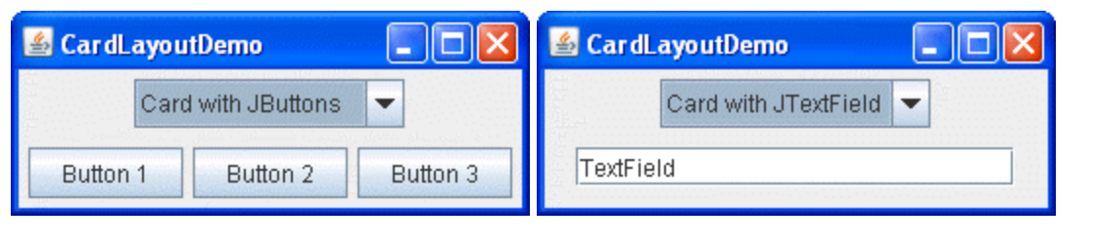
BY
Pasindu Mahima
Search . . .
Search . . .
CARD LAYOUT
The CardLayout class lets you implement an area that contains different components at different times. A CardLayout is often controlled by a combo box, with the state of the combo box determining which panel (group of components) the CardLayout displays. An alternative to using CardLayout is using a tabbed pane, which provides similar functionality but with a pre-defined GUI.

Slide 10
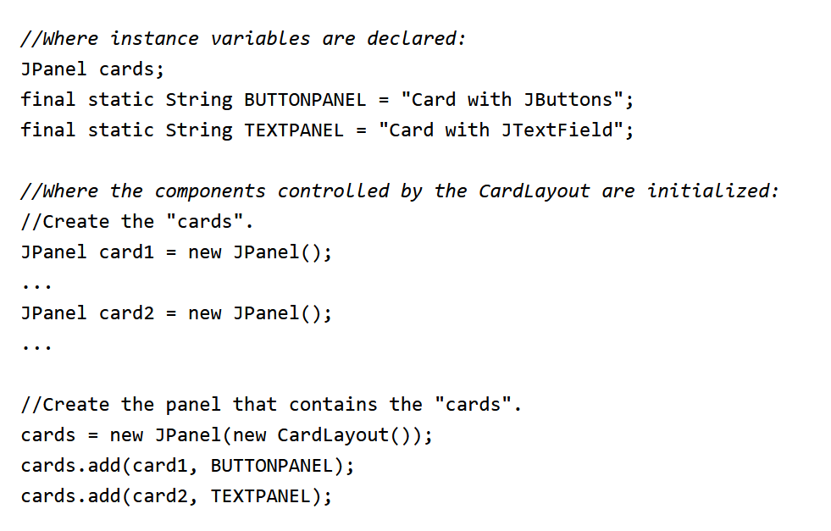
BY
Pasindu Mahima
Search . . .
Search . . .
CARD LAYOUT

Slide 11
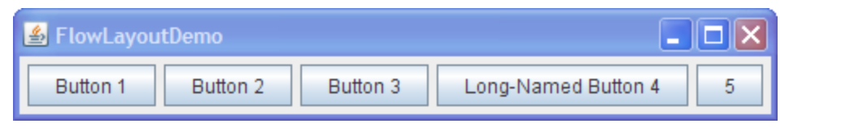
BY
Pasindu Mahima
Search . . .
Search . . .
FLOW LAYOUT (DEFAULT LAYOUT)
FlowLayout is the default layout manager for every JPanel. It simply lays out components in a single row, starting a new row if its container is not sufficiently wide.

Slide 12
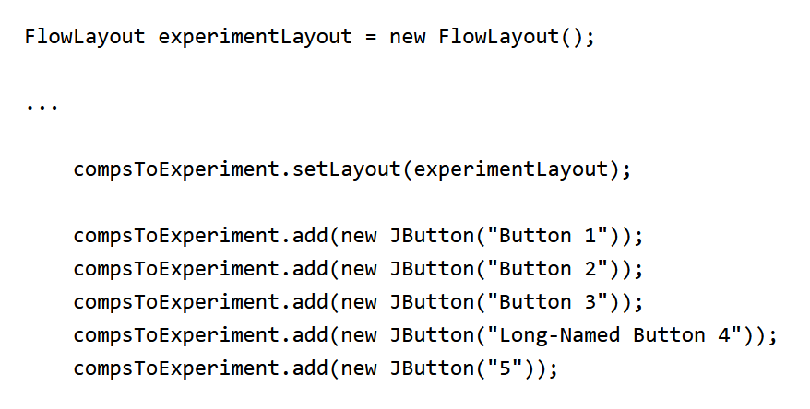
BY
Pasindu Mahima
Search . . .
Search . . .
FLOW LAYOUT (DEFAULT LAYOUT)

Slide 13
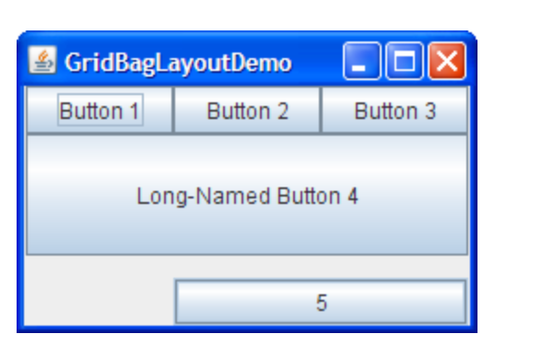
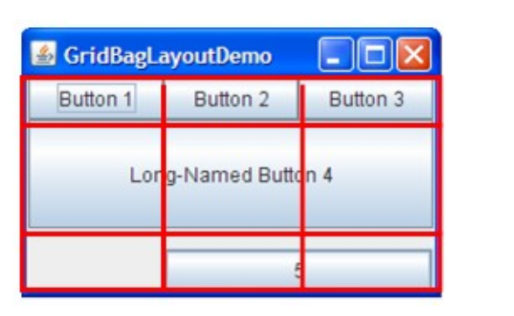
BY
Pasindu Mahima
GRID BAG LAYOUT
GridBagLayout is a sophisticated, flexible layout manager. It aligns components by placing them within a grid of cells, allowing components to span more than one cell. The rows in the grid can have different heights, and grid columns can have different widths.

Slide 14
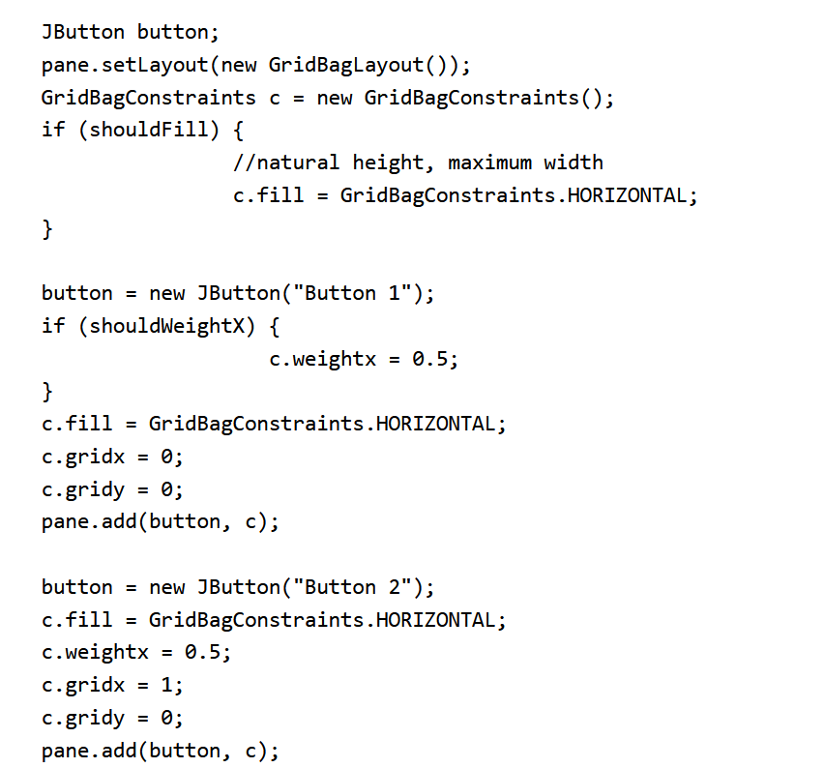
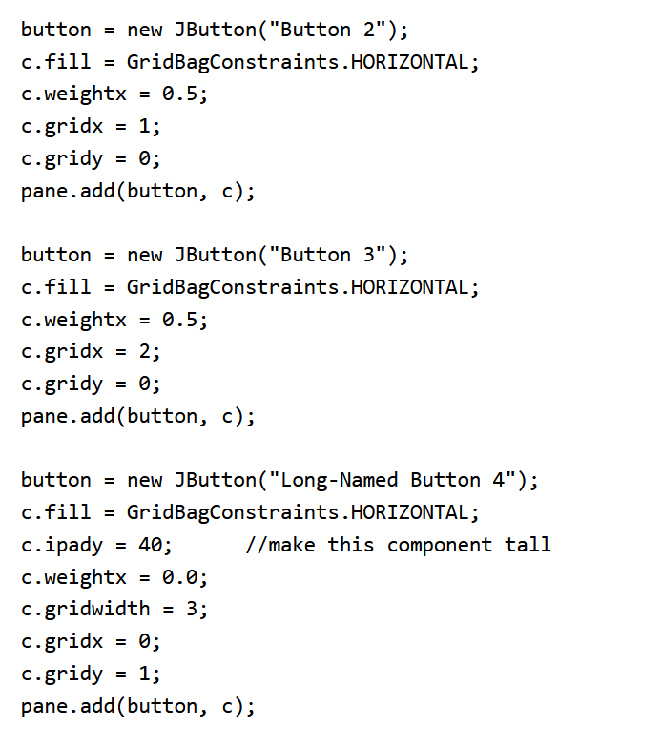
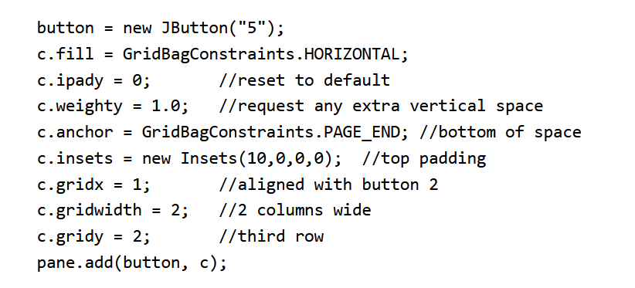
BY
Pasindu Mahima
Search . . .
Search . . .
GRID BAG LAYOUT

Slide 15
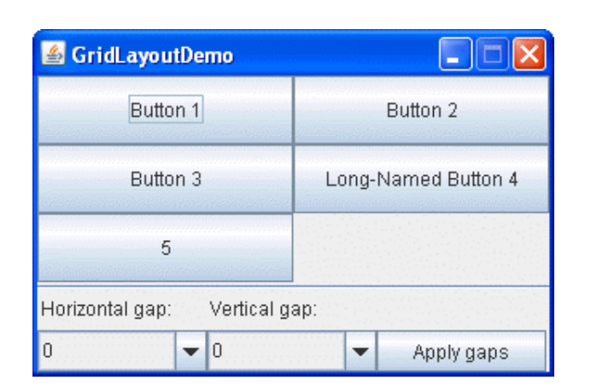
BY
Pasindu Mahima
Search . . .
Search . . .
GRID LAYOUT
GridLayout simply makes a bunch of components equal in size and displays them in the requested number of rows and columns.

Slide 16
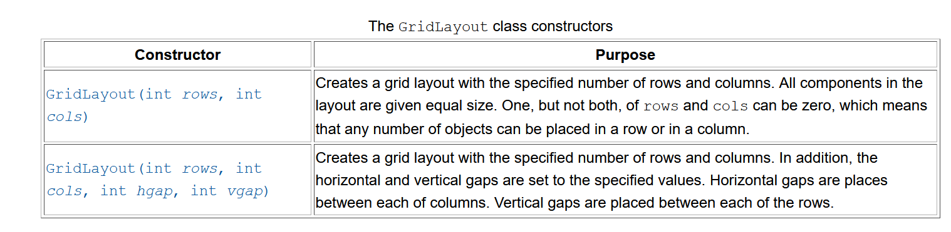
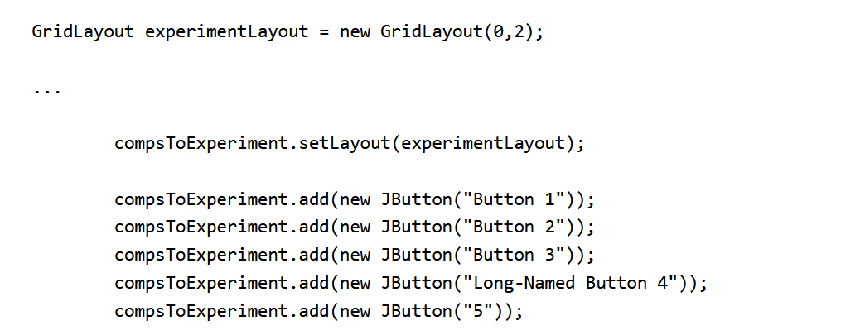
BY
Pasindu Mahima
Search . . .
Search . . .
GRID LAYOUT

Slide 17
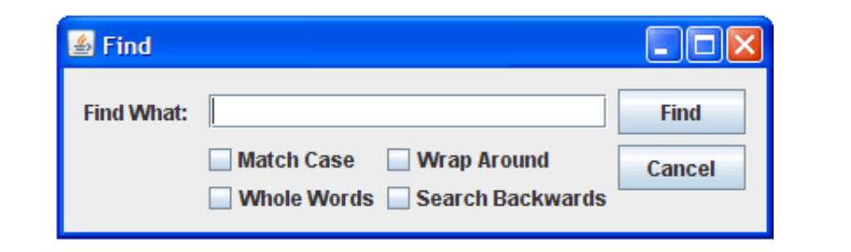
BY
Pasindu Mahima
Search . . .
Search . . .
GROUP LAYOUT
GroupLayout is a layout manager that was developed for use by GUI builder tools, but it can also be used manually. GroupLayout works with the horizontal and vertical layouts separately. The layout is defined for each dimension independently. Consequently, however, each component needs to be defined twice in the layout.

Slide 18
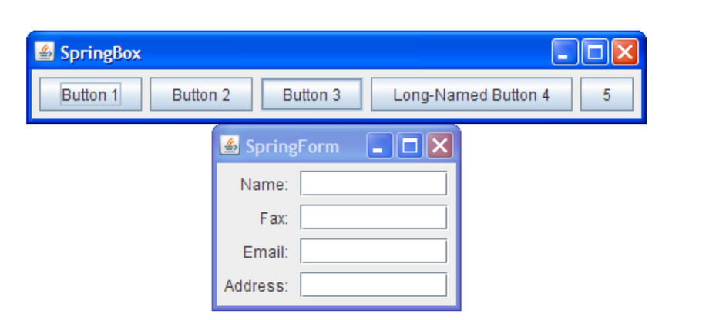
BY
Pasindu Mahima
Search . . .
Search . . .
SPRING LAYOUT
SpringLayout is a flexible layout manager designed for use by GUI builders. It lets you specify precise relationships between the edges of components under its control. For example, you might define that the left edge of one component is a certain distance (which can be dynamically calculated) from the right edge of a second component.

Slide 19

BY
Pasindu Mahima
Search . . .
THANK YOU
Social Profiles
Follow Ngator on social networks
Facebook : https://www.facebook.com/learnwithngator
Instagram :https://www.instagram.com/mahimapasindu/
GitHub : https://github.com/drgnhunter
LinkedIn : https://www.linkedin.com/in/pasindu-mahima-3a0031187/
END SLIDE

